Slide 1

Getting started with Azure IoT

Slide 2
Presenters
Mahindra Morar
Principle Integration Consultant
Datacom
Desiree Suligan
IoT Developer
Datacom

Slide 3
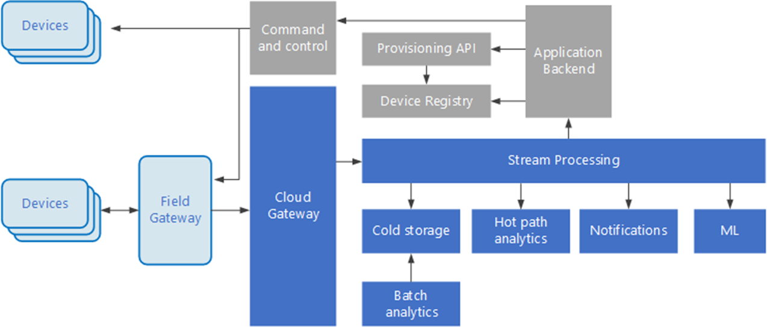
Solution Overview

Slide 4
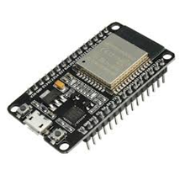
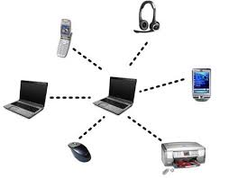
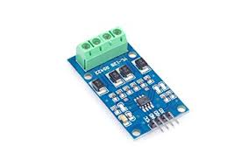
Devices
IP Capable
PAN
Low Power Devices
Notes:
3 classifications
PAN – Personal area network (Blue Tooth, USB)
RS323, 4-20ma Loop

Slide 5
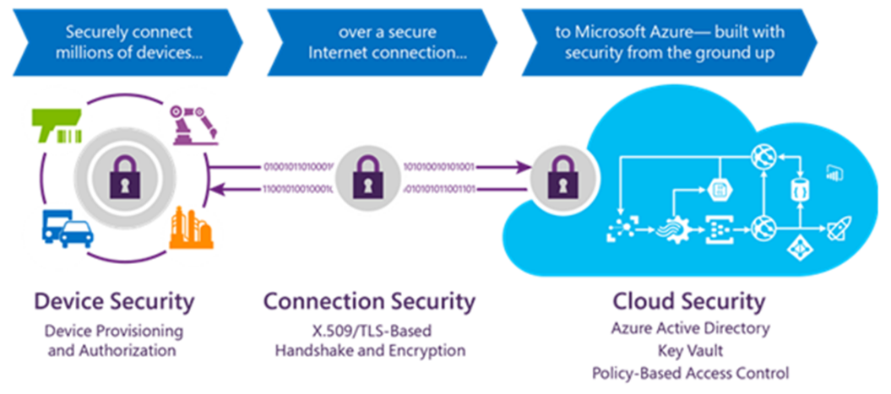
Security
Notes:
3 types of security
Compromised devices
Inbuilt encryption libraries on chip
DoS attacks
Shared Access Policies in Portal

Slide 6
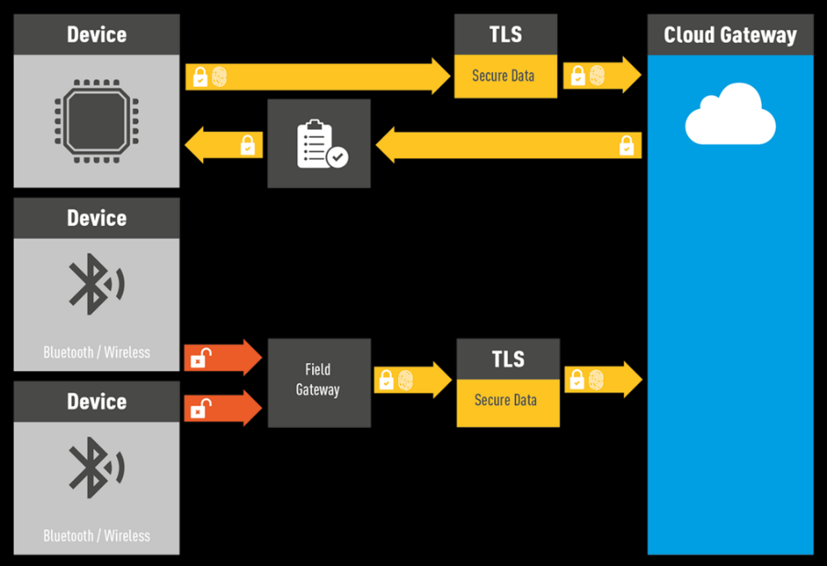
Field Gateway
Notes:
Devices not IP capable
No security
Message composition
Aggregate/Store then forward.

Slide 7
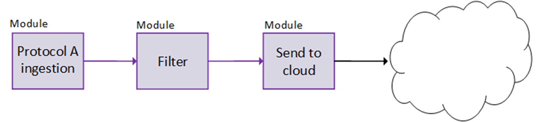
Azure IoT Gateway SDK
Notes:
Write Modules - Node.js, Java, C#, or C
Linux & Windows
3 prewritten modules
Call Azure Functions
Modules exchange data pub/sub

Slide 8
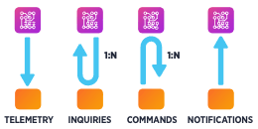
IoT Communication Patterns
Notes:
Telemetry: Data flows in one direction
Inquiries: Requests from the device looking to gather required information or asking to initiate activities
Commands: Commands from other systems sent to a device (or a group of devices) to perform specific activities expecting a result from the command execution, or at least a status for that
Notifications: Information flows in one direction from other systems to a device

Slide 9

Azure Data Protocols
Notes:
Other IoT protocols such as:-
CoAP (Constrained Application Protocol)
Websockets,
Rest/HTTP
Azure Supports MQTT & AMQP, HTTPS

Slide 10
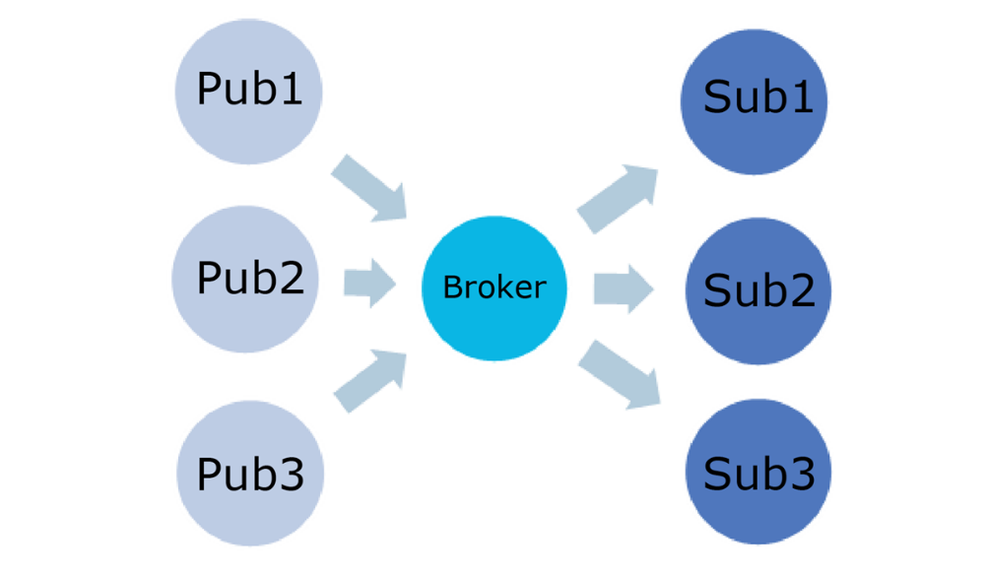
MQTT Data Protocol
Notes:
Messaging Queue Telemetry Transport
Developed by IBM for industrial sector. Designed for telemetry
Use Publish/Subscribe/Topic mechanism
Lightweight protocol
Small code footprint
Build on top of the TCP/IP protocol
Less network bandwidth
Retained Messages

Slide 11
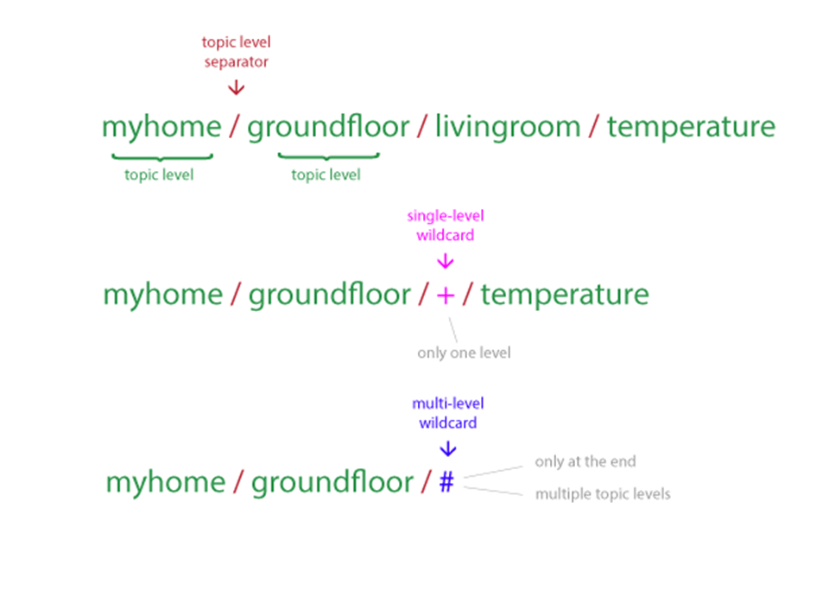
MQTT Data Protocol
Notes:
Topics

Slide 12
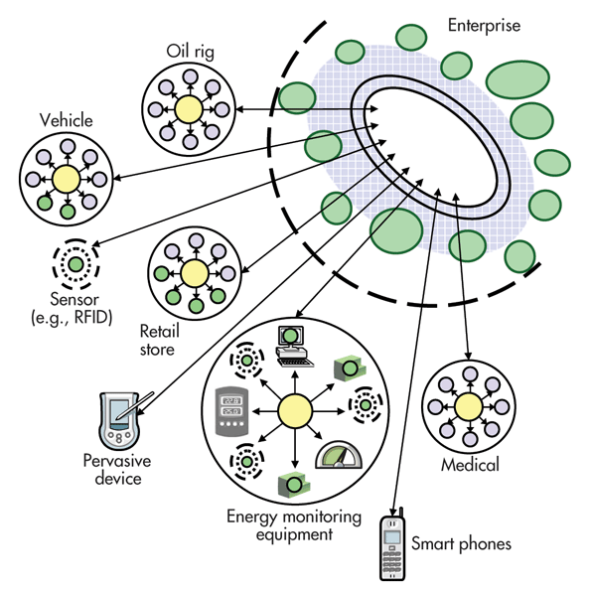
MQTT Example

Slide 13
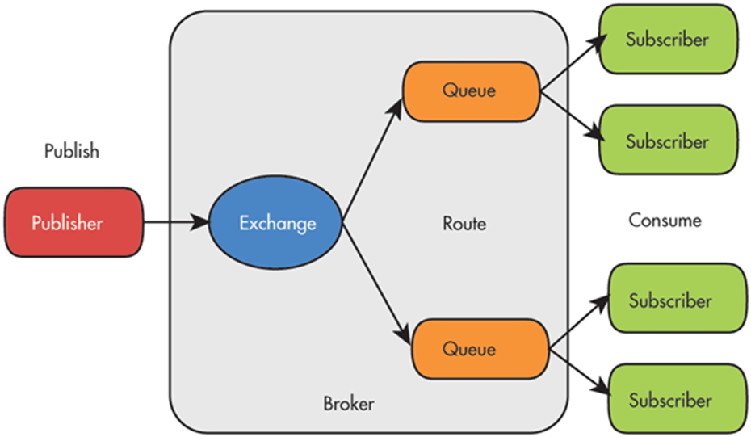
AMQP Data Protocol
Notes:
Advanced Messaging Queuing Protocol
Enterprise application oriented (Banking)
Peer-to-peer
Better support for security
Fully symmetric – both server and client initiate communication link. bi-directional
Verbose protocol but greater flexibility
Long lived connections
Binary communication
More messaging patterns (pub/sub, routing filters)

Slide 14
Protocol Use Scenarios
Rarely Connected
HTTPS
Low Latency
MQTT
AMQP
Low Resource
MQTT
HTTPS
Closed Ports
MQTT Websockets
AMQP Websockets
Notes:
Http – device to cloud poll 25 minutes
Low Resource – MQTT is binary

Slide 15
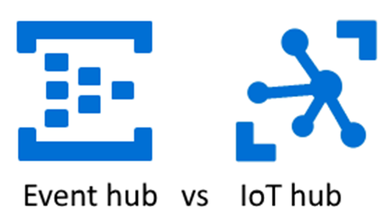
Azure Messaging Queues
Event Hubs
Ingestion only
Https/AMQP
Shared access keys
IoT Hubs
device-to-cloud, cloud to device
Https/MQTT/AMQP
Device twins
File upload
Device level access
Notes:
Event hub - 5k concurrent connections
Event hub partitions – scalability
Iot Hub - 1 million concurrent connections
Pricing Event Hub cheaper

Slide 16
IoT Hub High Availability & DR
IoT Hub Sharding
Secondary IoT Hub
Concierge service
Identity registry replication
Notes:
Partitioning

Slide 17
Device Registration/Management
Azure Portal
Prototyping
Windows IoT Core Dashboard
Connect with Windows Azure Creds
Store Key in Trusted Platform Module (TPM)
Azure IoT Hub Device Provisioning Service
Zero touch, bulk registration
Re-provisioning device, change in ownership or location
Bulk import/export using SDK
Blob store
Notes:
Unique key per device
Device self registration – manufactures,

Slide 18
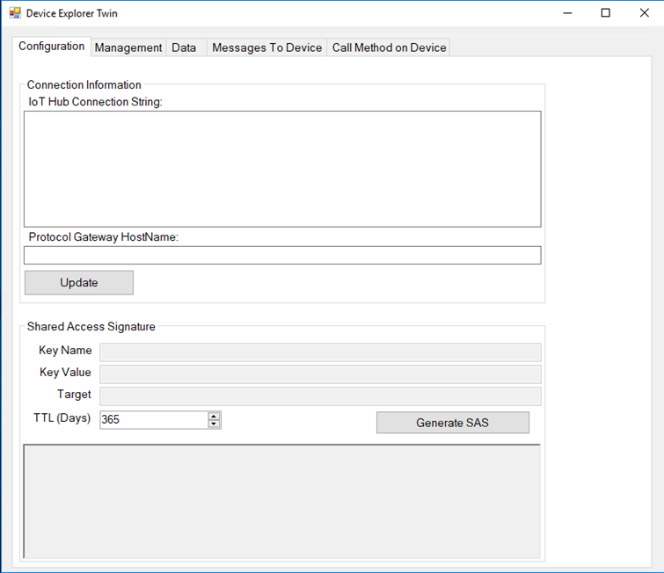
Device Explorer
Device Management
Receive data from devices
Send data to devices

Slide 19
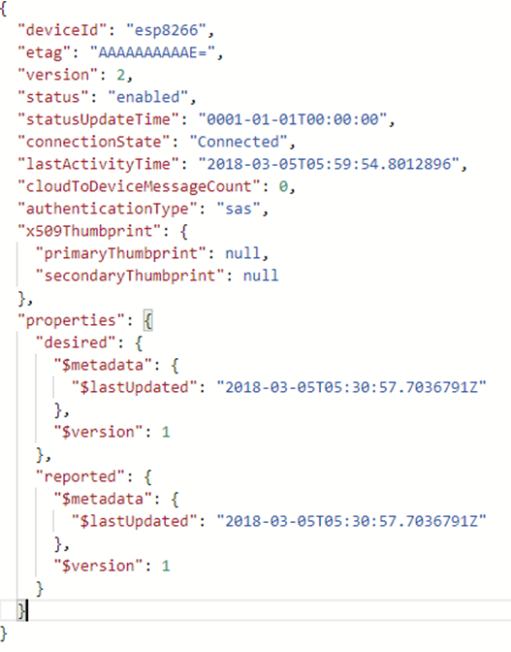
Device Twins
Not always connected
JSON structure
Custom Tags
Notes:
Virtual representation
Query using T-SQL like syntax

Slide 20
Data Consumption
Azure Stream Analytics
Azure App Services
Logic Apps
Storage
Azure blob storage
Azure Cosmos Db

Slide 21
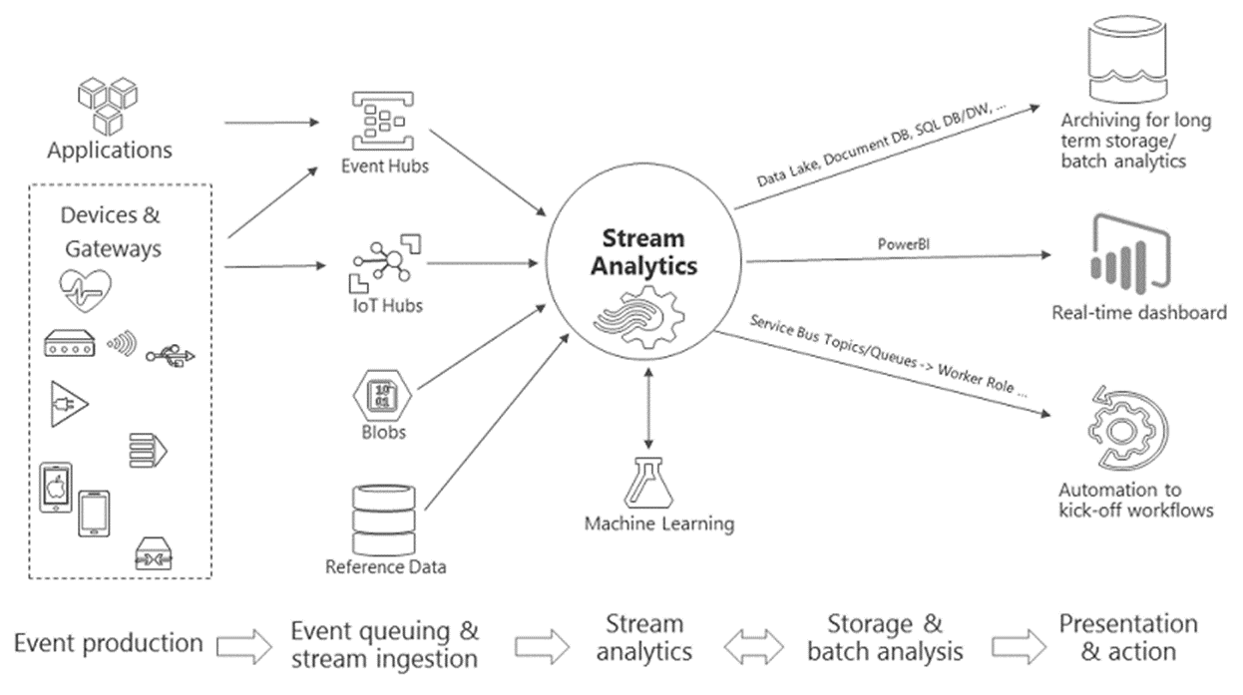
Data Analytics/Alerting
Notes:
SQL like query
1 GB of incoming data per second.
Tumbling window, Hopping window (**Who knows difference)
Can Web App instead of Stream Analytics
Power BI setup alerts

Slide 22
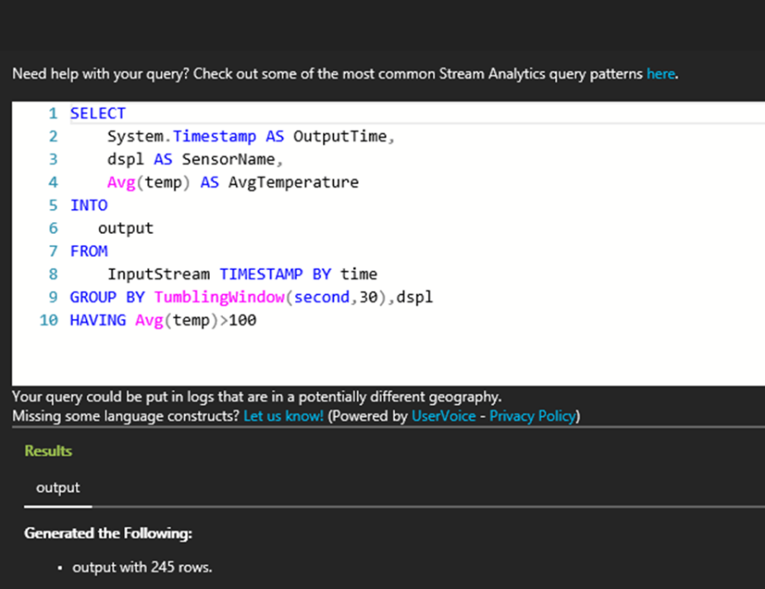
Streaming Insights sample query
Notes:
Average temperature > 100 deg last 30 sec

Slide 23
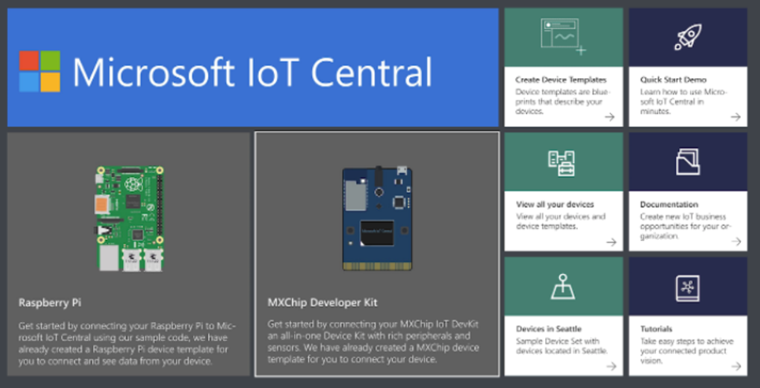
IoT Central
SaaS solution
Pre-configured templates
AD support
Notes:
Templated resources
Only need to connect and provision your devices
Can use simulated devices first before connecting physical devices
Can set thresholds e.g. for temperature such that when it reaches that threshold you get an alert e.g. via email.
Also gives suggestions for possible solutions.
Can see both real-time and historical data.

Slide 24

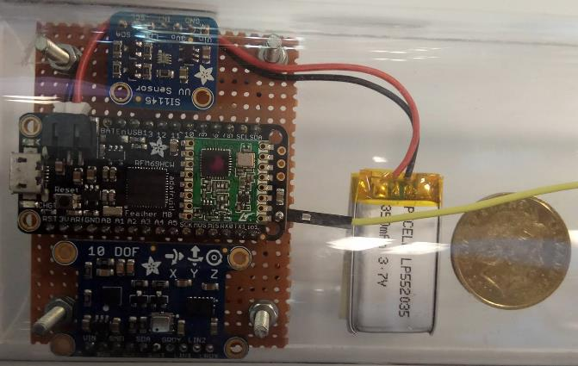
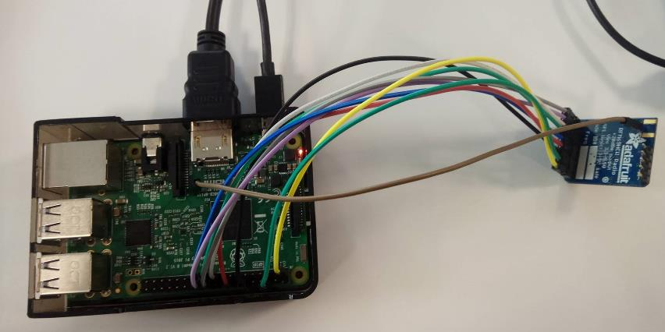
Goal: Send Telemetry Data to Azure
IoT Hub
Sensor Tube
Raspberry Pi + Transceiver
Notes:
Sensor Tube
Battery powered
2 sensors connected to an Arduino feather that acts as a radio transceiver
Transceiver connected to RPi receives telemetry data
Rpi runs a UWP app and sends data to IoT Hub

Slide 25
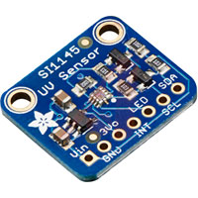

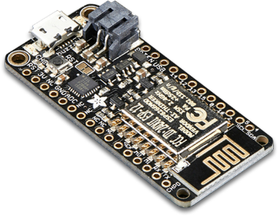
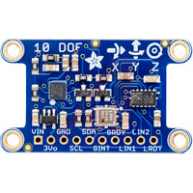
Sensor Tube

Slide 26

Sensor Tube
Arduino Feather M0
Packet radio (RFM69HWC)
Adafruit 10-DOF
Pressure
Temperature
Gyroscope
Magnetometer
Accelerometer
Adafruit SI1145
UV Index
Infrared
Visible Light

Slide 27
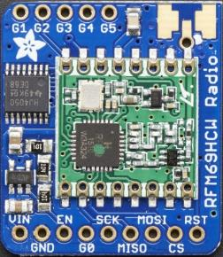
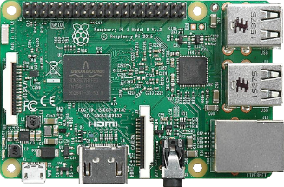

Raspberry Pi and Radio
Notes:
RP acting as Field Gateway

Slide 28
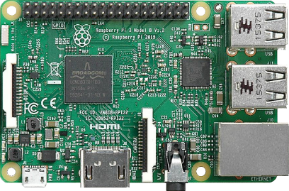
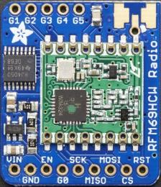
Raspberry Pi and Radio
Raspberry Pi 3
Microcontroller
Adafruit RFM69HCW Radio
Radio transceiver
Notes:
Raspberry Pi
Microcontroller
Acts as a mini computer
CPU: ARM Cortex A53 1.2 GHz
RAM: 1GB
Adafruit RFM69HCQ Radio
Radio transceiver for transmitting and receiving messages (i.e. bi-directional)
Compared to WiFi, Bluetooth, Zigbee and other wireless chipsets that use 2.4GHz, RFM69HCW is ideal for long distances that do not require fast transmission of data e.g. at 433MHz
Just needs same frequency and encryption key
Modules automatically does packetization, error correction and auto-retransmit

Slide 29
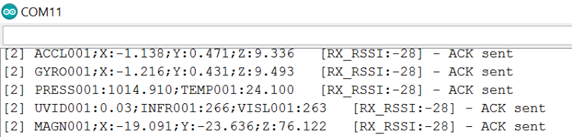

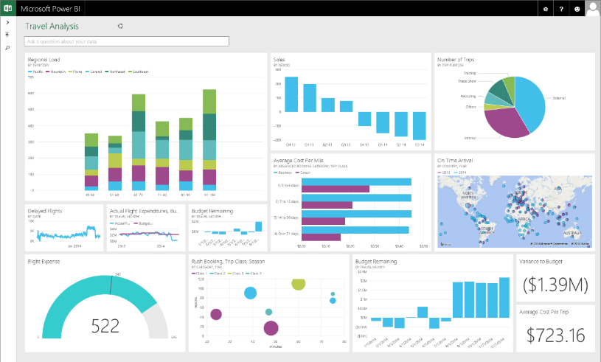

Analytics
Notes:
Sensor data sent to IoT Hub
IoT Hub to Stream Analytics
Stream Analytics to Power BI

Slide 30
DEMO

Slide 31



Reference material
My Blog – connectedcircuits.wordpress.com
Azure Device Explorer - https://github.com/Azure/iothub-explorer
Azure IoT Central - https://www.microsoft.com/en-us/iot-central
Stream Analytics - https://azure.microsoft.com/en-us/services/stream-analytics/
Field Gateway SDK - https://github.com/Azure/iot-edge

